Slide 1
OpenShipping.org
Workshop – January 19

Slide 2
API Tracking – Post endpoints
The first Standard Tracking API specification focuses on posting events
Multiple POST endpoints are available to control the access of different data providers (e.g. carriers, transporters, etc).
A POST endpoint contains:
Vehicule type: Vessel, Rail, Truck, or Air
Event ‘type/flavor’: Planned, Estimated, or Actual
A POST endpoint contains a parameter specifying the object to be tracked :
A consignment reference (e.g. booking number)
An equipment reference (i.e. equipment reference)
Thus, an example of tracking estimated vessel events for a given container is:
POST /equipments/{equipmentNumber}/estimatedVesselEvent
Note: here, we assume that posting any event type (planned, estimated or actual) could be done at both consignment & equipment levels.

Slide 3
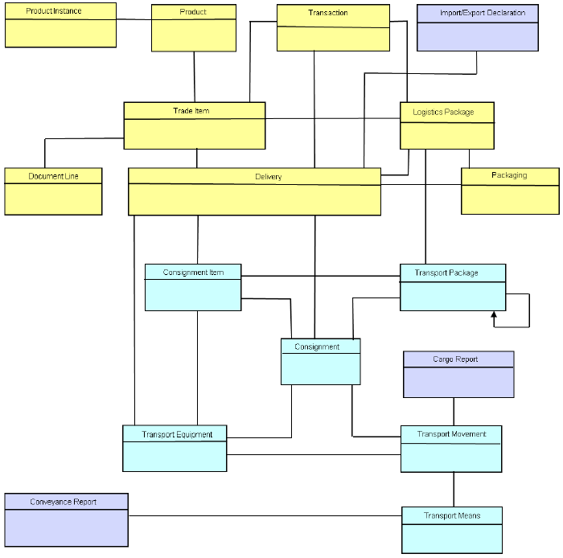
API Tracking – CEFACT Model API resources vs. CEFACT resources
CEFACT model differentiates between Trade Data (yellow) and Transport Data (blue).
Tracking API main entities:
Consignment
Yellow ‘Delivery’ CEFACT resource (i.e.‘Shipment’) is represented as an attribute of this API ‘consignment’ entity
Transport
Equipment
Blue ‘Transport Equipment’ CEFACT resource is split into two ‘Transport’ & ‘Equipment’ entities.
Blue ‘Transport Means’ will be represented in the API ‘Transport’ one.
Event
Blue ‘Transport Movement’ CEFACT resource is covered by this ‘event’ entity, which aims to be more generic/extensible as described later.

Slide 4
API Tracking – Components 1/4 Generic definition of an event
Event
consignementData
equipmentData
transportData
vehicule*
location*
terminal
date*
position
….
3 event ‘types’ are defined:
« PlannedEvent »
« EstimatedEvent »
« ActualEvent »
They are inheriting from « Event » generic one.
This allows flexibility in adding specific properties, and/or defining the required ones according to each type.
For instance, the equipment reference should be mandatory for ‘estimated’ and ‘actual’ events (when operational transport has started).
Planned Event
Additional properties:
-plan Ref
Estimated Event
required properties:
-equipmentReference *
Actual Event
required properties:
-equipmentReference *

Slide 5
API Tracking – Components 2/4 Case 1: Physical move
Event
consignementData
equipmentData
transportData
vehicule*
location*
terminal
date*
position
….
An event could correspond to a physical move.
The description of this ‘move’ event has been discussed during the last workshop.
A large part of move’ attributes could be considered as part of the generic event description, like:
Vehicule
Location
Date
Position
…
The additional attributes, specific to a move are :
moveCategory: Load, Departure, Arrival, Discharge.
Note: if needed, this category information could be added to post endpoints (as in first Nis’s poposal)
moveCode: the UN/EDIFACT's physical move codification
moveDescription: the move description
MoveEvent
moveCategory
moveCode
moveDescription

Slide 6
API Tracking – Components 3/4 Case 2: Smart Event
Event
consignementData
equipmentData
transportData
vehicule*
location*
terminal
date*
position
….
With new technologies, like IOT, new ‘Smart Events’ should be covered.
The description of a smart event will inherit from the generic event one.
As for move events, we propose to provide:
eventCategory: operational, alerting, monitoring, geofencing, etc (to be defined).
eventCode: the new smart event codification to be done
eventDescription: the event description
In addition, new « MetaData » attribute is proposed. It provides:
assetID, and assetType
deviceID (corresponding to the IOT device installed on the asset)
GenerationDate
Software name & version
…
SmartEvent
moveCategory
voveCode
moveDescription

Slide 7
API Tracking – Components 4/4 Case 2: Smart Event
Event
consignementData
equipmentData
transportData
vehicule*
location*
terminal
date*
position
….
In addition, new « Event Detail » attribute is also proposed.
A common work should be done to define the description of this attribute, for each smart event (i.e. the list of ~200 events identified today)
We propose to keep the definition of this attribute very generic in the Tracking API
However, this API should be provided along with an event ‘catalog’ that defines each smart event details (cf. externalDocs link)
Two examples of « Event Details » are initiated in the event catalog swagger file.
RefeerMeasurement (in “Equipment/Monitoring” category)
Late (in “Tracking/Alerting” category)
Note: this swagger will not be implemented. The GET methods allow just to categorize the different smart event definitions….
SmartEvent
eventCategory
eventCode
eventDescription
metaData
eventDetails

